Slide 1
DevOps and Azure
Part 1: Azure DevOps/TFS Components
Joshua Davis Azure Customer Engineer joshua.davis@microsoft.com https://github.com/a11smiles/devops-and-azure

Slide 2
Purpose
To understand the definition, roles, and processes within a DevOps culture in order to:
Identify necessary stakeholders
Successfully discover, plan, and migrate supporting infrastructure
Upskill and increase value in knowledge, platforms, and controls for customers
NOTE: The intended purpose is not an exam prep, but the learnings from this series should contribute greatly to your success.

Slide 3
Intended Audience
Developers
CI/CD processes for managing changes
Configuration of processes and governance for Azure DevOps
Migration of code from disparate systems to Azure DevOps
Infrastructure
Understanding the components—and how they are interrelated—of a source control and build/deployment infrastructure
Security planning for intercommunication between systems and platforms
Data
Understanding and planning for change management of database platforms
Enhancing reporting of various CI/CD metrics to improve code quality and increase efficiency

Slide 4
What Will Not Be Covered
TFS Configuration
Implementation and Security Administration
Licensing
Test Plans and Suites
Our Goal: Process, not Administration

Slide 5
Outline
Azure DevOps/TFS Components Examining and understanding the architecture of a typical TFS infrastructure for proper discovery and planning of a migration.
Processes Understanding various processes for implementing and managing DevOps.
Governance Exploring available controls for governing and protecting code, builds, and deployments.
Automation Transitioning from manually-intensive processes and governance for scale.

Slide 6
DevOps Defined
“An organization that embraces cultural change to affect
how individuals think about work,
value all the different roles that individuals have, accelerate business value, and measure the effects of the change.”
Jennifer Davis Software Engineer, Chef
Ryn Daniels Senior Operations Manager, Etsy

Slide 7
DevOps Danger
“The danger for a movement that regards itself as new is that it may try to embrace everything that is not old.”
Lee Roy Beach et al. Naturalistic Decision Making and Related Research Lines

Slide 8
History of Azure DevOps
Microsoft Visual Source Safe
Visual Studio Team System (2005, 2008)
Team Foundation Server (2010, 2012, 2013, 105, 2017, 2018)
Azure DevOps Server (2019)
Visual Studio Online (2013)
Visual Studio Team Services (2015)
Azure DevOps Services (2018)
On-Premises
Cloud
https://en.wikipedia.org/wiki/Microsoft_Visual_SourceSafe
https://en.wikipedia.org/wiki/Azure_DevOps_Server

Slide 9


TFS Infrastructure
Administration Server
Admin Server
Administrative console for managing admins, projects, and configuration for auxiliary services
Primary server for connecting to source control via services
Project managers can connect using Excel plugin
Source Control
GitHub
GitLab
Bitbucket
SVN/CVS
Issue Management
GitHub
GitLab
JIRA
Alternative Solutions

Slide 10

TFS Infrastructure
Admin Server
Database (SQL) Server
SQL Server
Stores all code and artifacts
Stores configuration for SharePoint and Project Server integration
Retains all work item history
Source Code
File system
PostgreSQL/MySQL/Oracle
Work Item History
PostgreSQL/MySQL/Oracle
Alternative Solutions

Slide 11
TFS Infrastructure
Alternative Solutions
Jenkins
TeamCity
Bamboo
Travis CI
CircleCI
AppVeyor
Admin Server
SQL Server
Build Agent
Build Agent
Can be different types of platforms (Windows, Mac, Unix), architecture (x86, 64-bit), distros (CentOS, Ubuntu, RHEL), and configurations (frameworks, drivers, capabilities, memory)
Multiple configurations can be used for diverse distributions and/or automated testing
Builds can be configured for various rules (check-ins, scheduled, manual)
Builds can be utilized for code quality via “gates”
Increasing build agents can increase parallelization
Build outputs result in a “drop”

Slide 12
TFS Infrastructure
Alternative Solutions
App Deployment
Bamboo
Octopus
Infrastructure Deployment
Ansible
Puppet
Chef
Docker
Kubernetes
Terraform (standalone)
Admin Server
SQL Server
Build Agent
Release Management
Release Management
“Built-in” functionality of the Administration Server
Responsible for administering (and automating) releases, including version history and auditing
Enables roll-back capabilities
Schedules releases for deployment
Releases can be configured for various rules (CI/CD, scheduled, manual)
Releases can be “gated”

Slide 13
TFS Infrastructure
Alternative Solutions
App Deployment
Bamboo
Octopus
Infrastructure Deployment
Ansible
Puppet
Chef
Docker
Kubernetes
Admin Server
SQL Server
Build Agent
Deployed on “end” environment (development, QA, staging, production)
Connects to the “Release Management” agent for receiving releases
Configures received release for local deployment
Release Management
Deployment Agent
Deployment Agent

Slide 14
TFS Infrastructure
Core
Build/Release
Geo-Distributed
Release Management
(Admin Server)
Admin Server
SQL Server
Cache Server
SQL Server
Build Agent
Deployment Agent
(Optional)
(Optional)

Slide 15
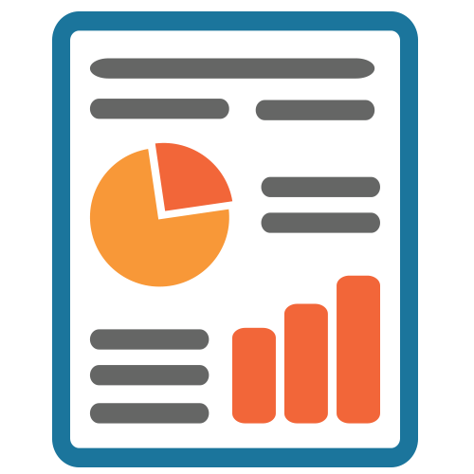
TFS Infrastructure Auxiliary Services
SQL Server Reporting and Analysis Server
SSRS/SSAS Server
Can be two different servers (SSRS vs. SSAS) or a single server
Stores all dimensions and reports for code and requirements churn
Must be configured separately within the TFS Administrative console

Slide 16
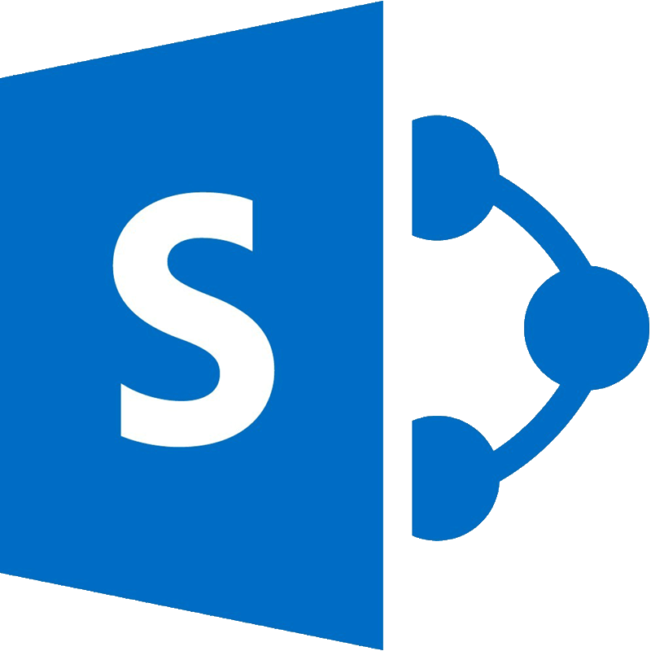
TFS Infrastructure Auxiliary Services
SSRS/SSAS Server
SharePoint Server
SharePoint Server
Integration with a “Team Site” template
Team Site provides centralized reporting for stakeholders without requiring permissions within TFS
Team Site allows project teams and stakeholders to upload additional collateral (BRDs, Func Specs, Visio, Photoshop) without needing source control
Originally, team “chat” with Yammer (additional functionality has been added to TFS since, along with MSFT Teams)

Slide 17
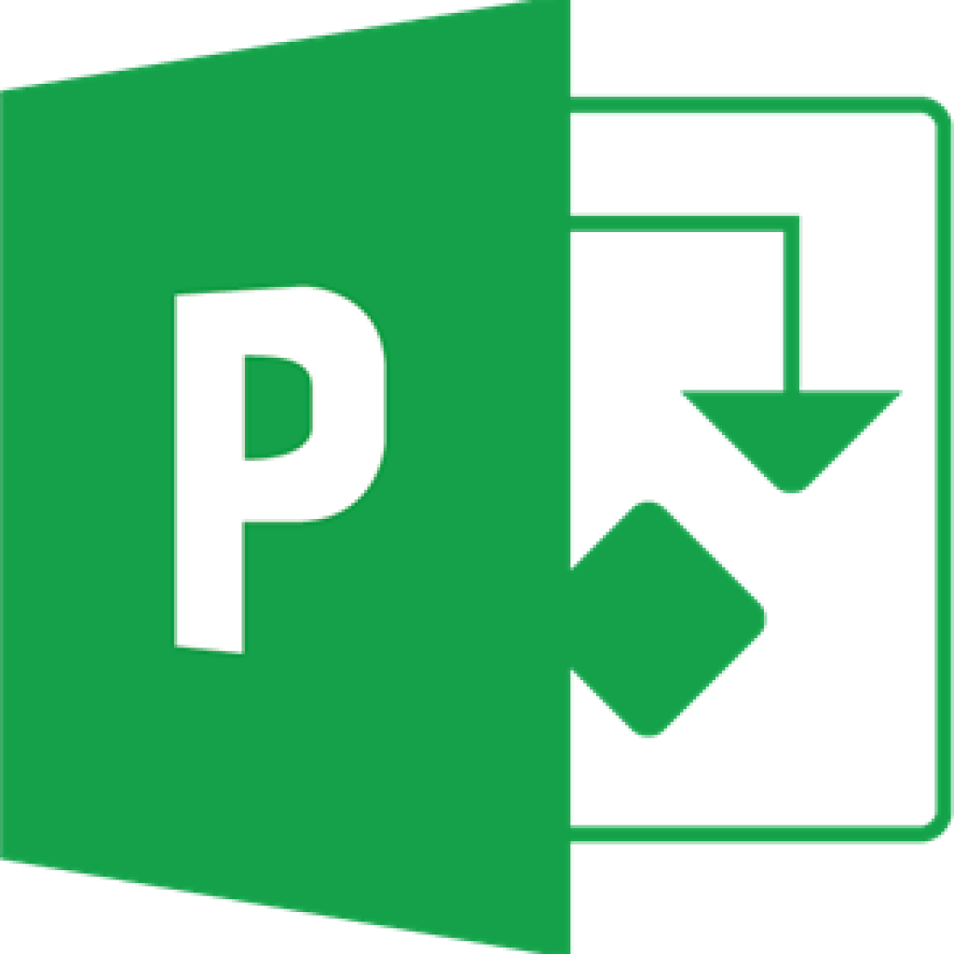
TFS Infrastructure Auxiliary Services
SSRS/SSAS Server
SharePoint Server
Project Server
Project Server
Used by teams leveraging formal project flows and processes
Native integration between Project tasks and TFS tasks
Enables developers to assign dependencies and hours to tasks which roll up to Project Server giving project managers greater visibility

Slide 18


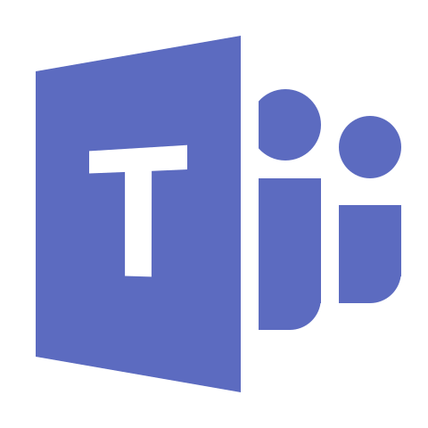
Azure DevOps Infrastructure
Cloud
Admin Server
SQL Server
Build Agent
Deployment Agent
On-Premises
Auxiliary
Azure DevOps Service
Build Agent
Deployment Agent
Power BI
Teams
(Optional)
(Optional)

Slide 19
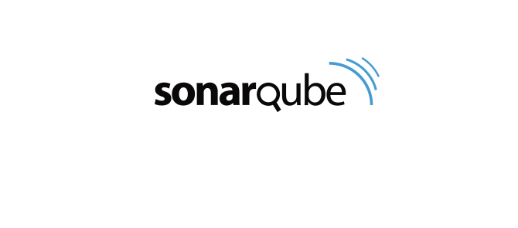
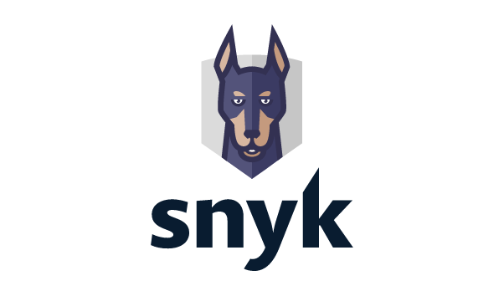
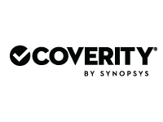

3rd-Party Services

Slide 20
Centralized vs. Distributed Version Control
Centralized
Typically easier to user for beginners
Single server stores repository and provides access to all clients
History is stored on server
Main server, because it is the central source of truth, must be backed up
Merge conflicts can be more complicated and take greater effort to resolve
Examples: TFSVC, SVN, CVS
Distributed
Concepts are a little more difficult for beginners
Every user has a local copy of the repository
Each user as a copy of the history
Server should be backed up, but if it goes down, every user has a copy of the repo
Merge conflicts are typically much simpler
Examples: Git, Mercurial

Slide 21
TFS to Azure DevOps Migration Guide
Guidance to import TFS databases (project collections) and migrate to Azure DevOps Services.
https://www.microsoft.com/en-us/download/details.aspx?id=54274
IMPORTANT: Each on-premises project collection will require a separate Azure DevOps tenant.

Slide 22
Can Subversion (SVN) Be Migrated to Azure DevOps?
Yes.
Create a Git repo in Azure DevOps
Convert SVN to Git using git svn https://git-scm.com/book/en/v2/Git-and-Other-Systems-Migrating-to-Git#_subversion
Check repo into Azure DevOps

